Slide 1


Faculty of Engineering & Technology CAPSTONE PROJECT END-TERM EVALUATION
SPYHUB- Multiple techniques to detect Copy-Move Image Forgery Project Guide - Prof. Sajeeda Shikalgar
Group : B37
Aditya Dhenge(1032180067)
Palak Mallawat (1032181231)
Rashi Madnani (1032181247)
Dhanashree Lodhe (1032181251)
Number of Online Meetings: Every Tuesday Slides approved by the guide: Yes.

Slide 2
AGENDA
Objective
Introduction
Literature Survey
Problem Statement
Proposed Method
Applications
System Architecture
Use case diagram
Activity Diagram
Schedule diagram
Test Cases
Performance analysis/ Results
Publication details
Conclusion
References

Slide 3
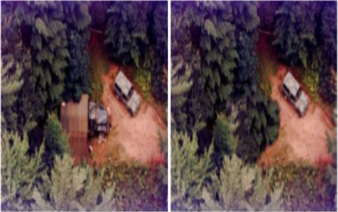
Objectives
With the headway of the advanced image handling software and altering tools, a computerized picture can be effectively controlled.
The identification of image manipulation is vital in light of the fact that an image can be utilized as legitimate confirmation, in crime scene investigation, and in numerous different fields.
The image forgery detection techniques intend to confirm the credibility of computerized pictures with no prior information about the original image.

Slide 4
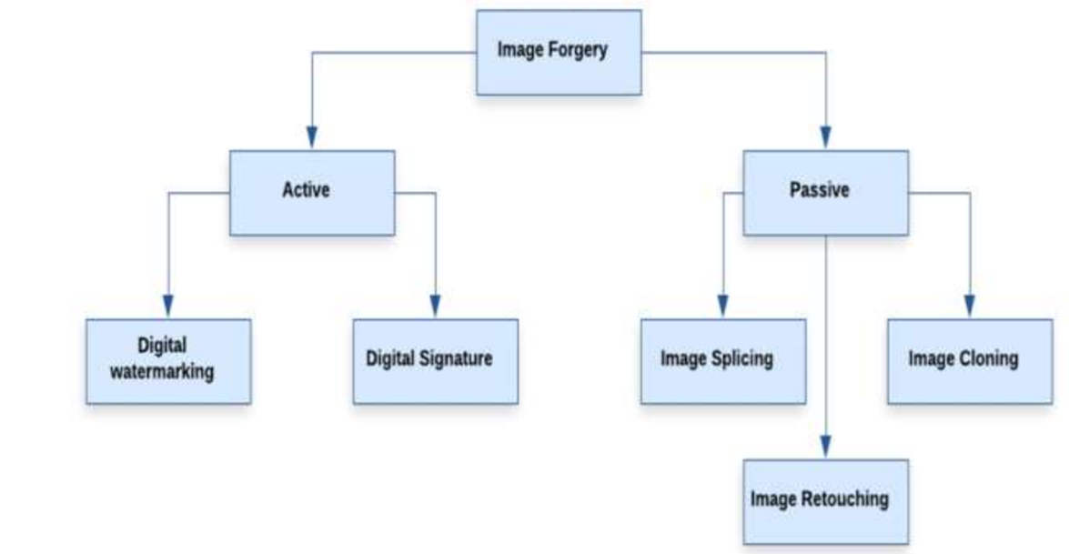
Types of Image Forgery

Slide 5
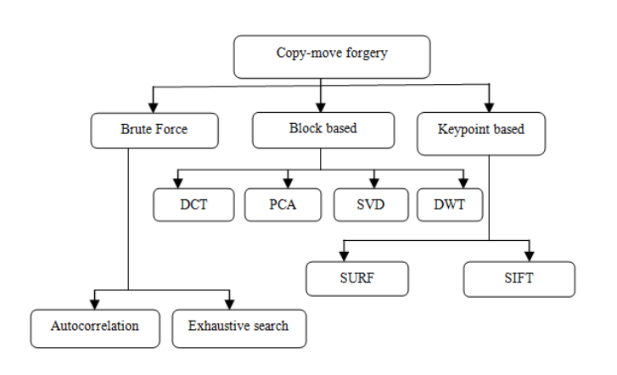

Slide 6
LITERATURE SURVEY
Paper Name | Method Used | Forgery Detection | Characteristics/ Research Gap | Year
Deep Learning Local Descriptor for Image Splicing Detection and Localization | Convolutional Neural Network (CNN) | Image splice detection and localization scheme | It is highly accurate and robust to image compression (JPEG). The disadvantage is very high complexity. | 2020
Image Splicing Detection using Deep Residual Network | Using CNN and support vector machine, K nearest neighbor and Naïve Bayes | Detecting Spliced image forgery | Has good accuracy and ability to find the location of the forgery region. But it does not work well for copy-move image forgery and requires a system with high performance to handle this algorithm. | 2019

Slide 7
Paper Name | Method Used | Forgery Detection | Characteristics/ Research Gap | Year
Image splicing forgery detection combining coarse to refined convolutional neural network and adaptive clustering | Convolutional neural network (C2RNet) and diluted adaptive Clustering | Detect Spliced image forgery | It decreases the time and complexity. One of the disadvantages of this method is poorer in Recall than many other comparison algorithms. | 2019
A review paper on digital image forgery detection techniques | Detection image forgery using a pixel based algorithm | Detection Copy-move and splicing image forgery | This method has good accuracy and high reliability. On the other side, this method needs more time and has less accuracy to detect forgery from the noisy image. | 2017

Slide 8
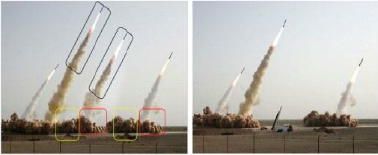
Problem Statement
To design a system to detect a passive type of image forgery, copy move forgery, using various keypoint based method like SIFT and SURF and Saving the results by highlighting the forged areas.

Slide 9
Proposed Method
Our project aims at employing different approaches to detect Copy-Move Forgery. We plan to employ different Key Point based methods such as Scale Invariant Feature Transform (SIFT) and Speeded Up Robust Features (SURF) for feature extraction. We further plan use. Random Sample Consensus (RANSAC) algorithm to localize the forged regions which is compatible with both SIFT and SURF and to remove wrong matches thus giving our model better accuracy.
Our project will allow the user to input an image in which they want to detect forgeries. They will further be given an option of selecting which method they want to employ for CMFD. The model will then detect and highlight the forged areas. The user can then upload another image or close the program.

Slide 10
Applications
The detection of image manipulation is very important because an image can be used as legal evidence, in forensics investigations, Health care, legal documents, Journalism to spread fear and in many other fields.
The pixel-based image forgery detection aims to verify the authenticity of digital images without any prior knowledge of the original image.

Slide 11
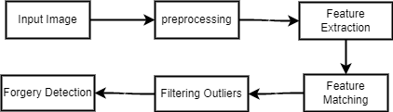
Low level design
SYSTEM ARCHITECTURE

Slide 12
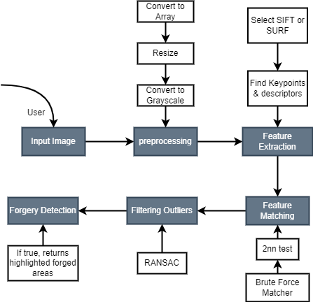
High level design
SYSTEM ARCHITECTURE

Slide 13
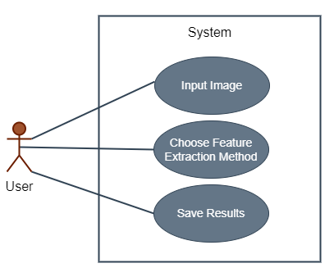
USE CASE DIAGRAM

Slide 14
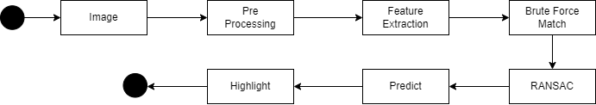
ACTIVITY DIAGRAM

Slide 15
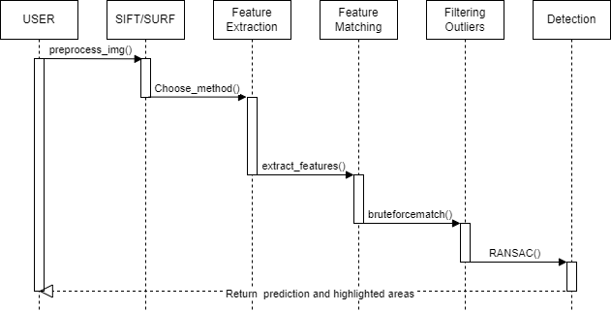
SEQUENCE DIAGRAM

Slide 16
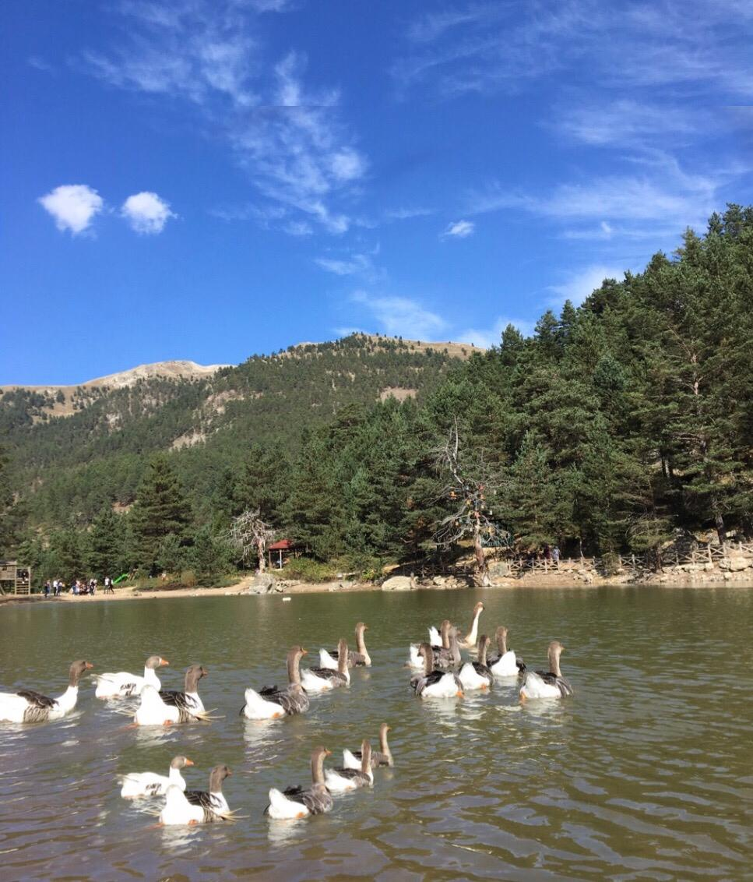
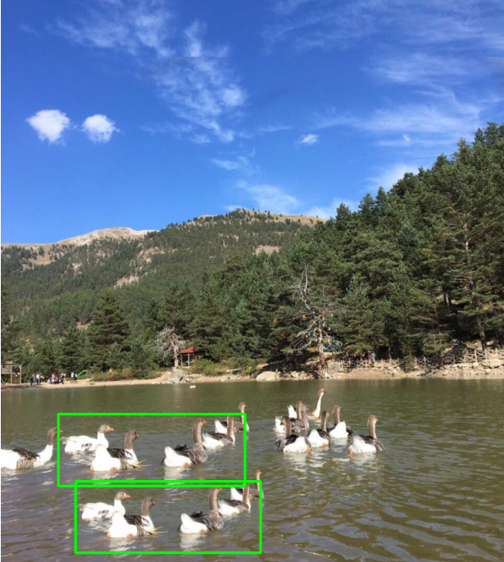
Test case 1: Copy move forgery done once
Input: Forged image of ducks swimming in a lake

Slide 17
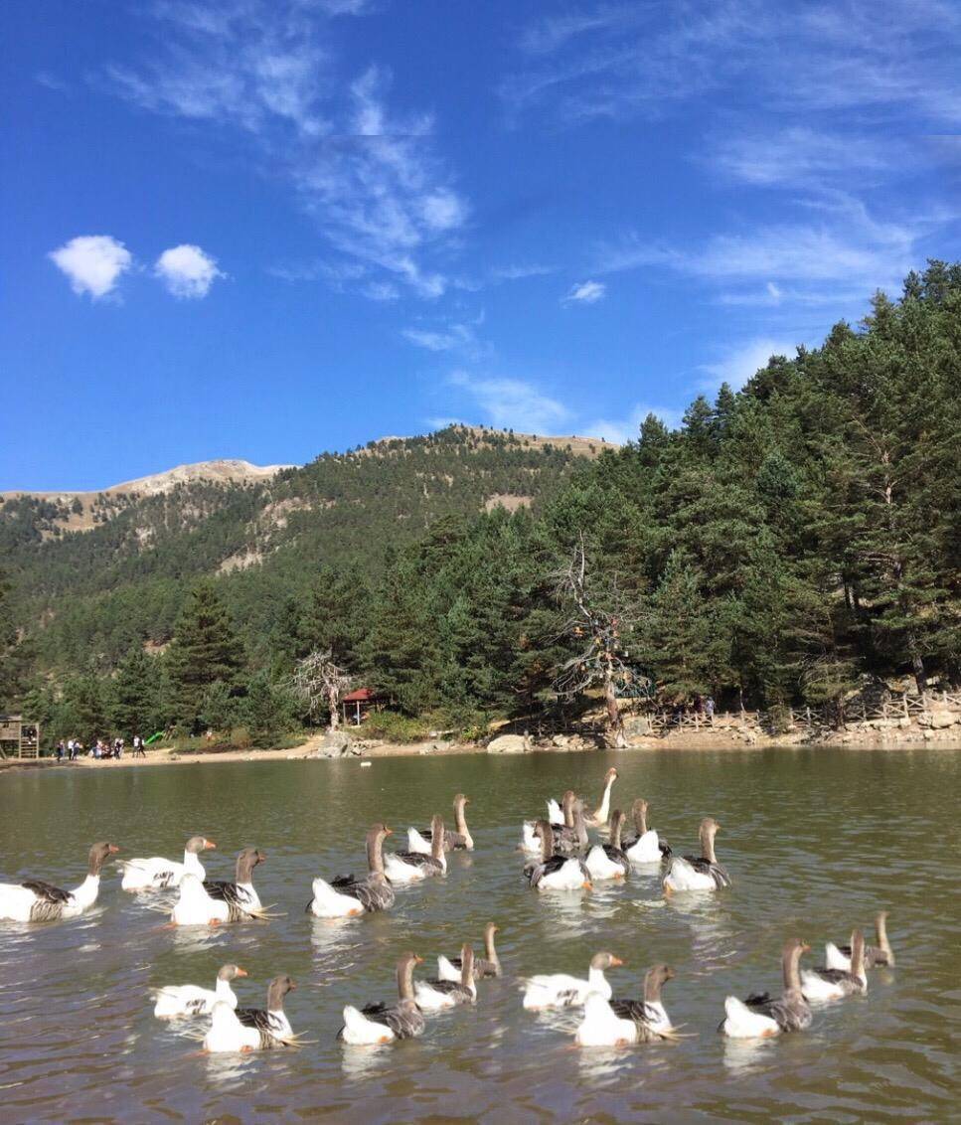
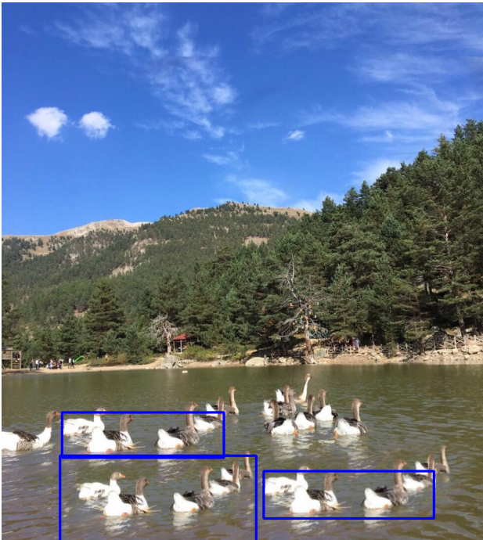
Test case 2: Copy move forgery done twice
Input: Forged image of ducks swimming in a lake

Slide 18
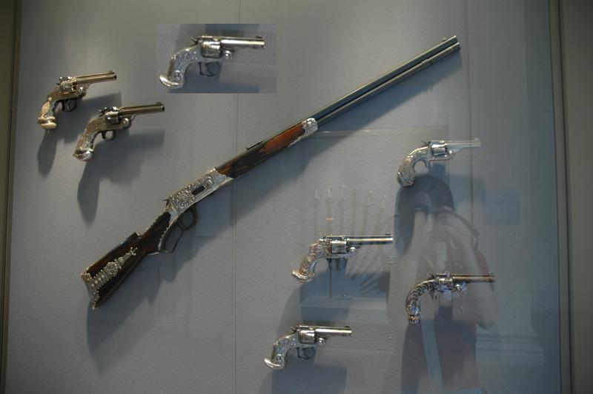
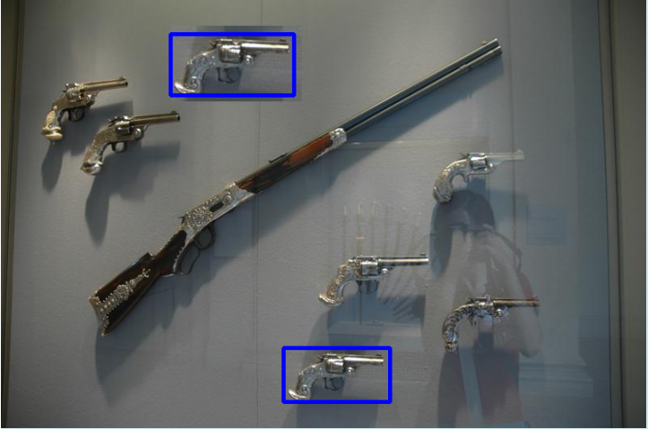
Test Case 3: Copy move forgery scaled
Input: Scaled Pistol images copy-pasted

Slide 19
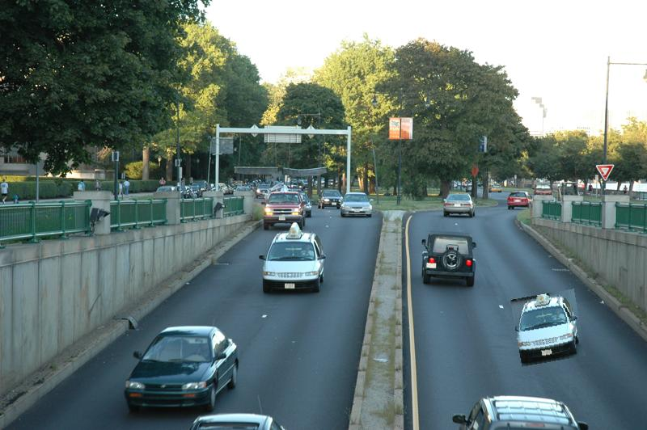

Test Case 4: Copy move forgery scaled and rotated:
Input: Scaled and Rotated Pistol images copy-pasted

Slide 20
Results and discussions
We have successfully implemented SIFT and SURF techniques to detect Copy-Move Forgery. We have tested our project with 15 user input images, and have received a positive output. These images have different type of forgeries done in them. Our model performs accurately regardless of the scaling and rotation of the forged areas.

Slide 21
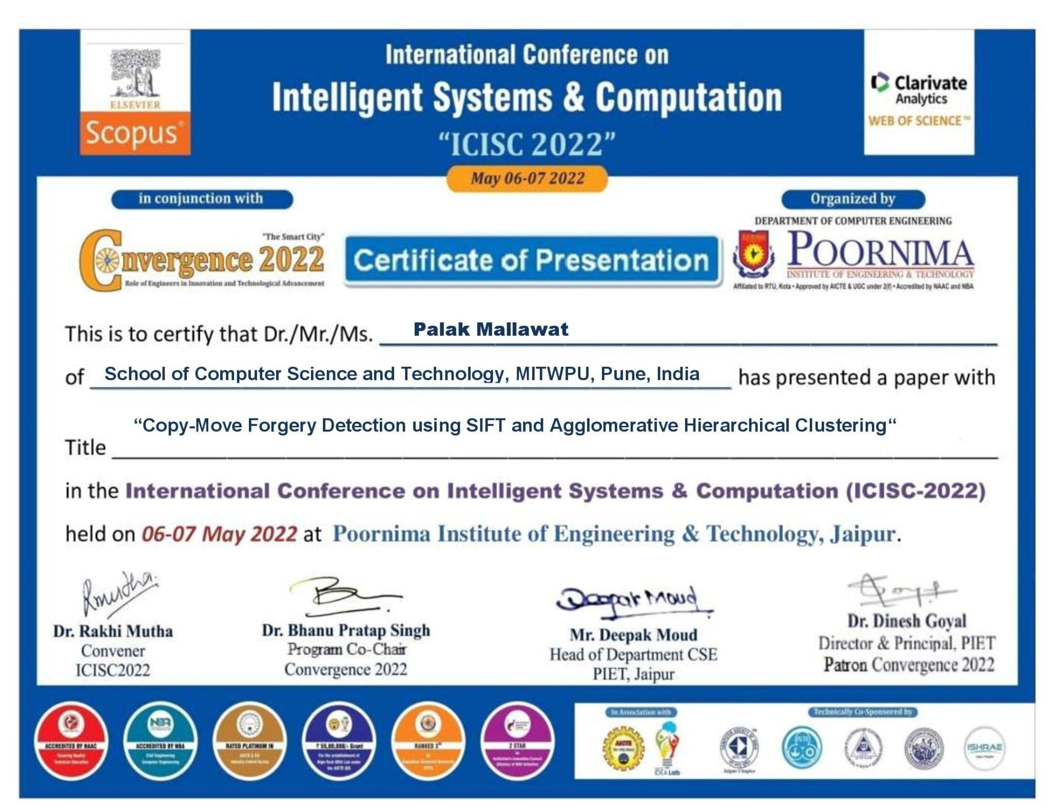
Paper Publication details and certificate

Slide 22
CONCLUSION
Thus, we have successfully implemented SIFT and SURF techniques to detect Copy-Move Forgery. We have tested our project with 15 user input images, and have received a positive output. We’ve also implemented the RANSAC algorithm to remove outliers and hence increase the overall accuracy of our model. The given project successfully highlights the forged regions in different test cases and helps users with smooth detection of the same. The GUI created by us is user-friendly where in users can easily navigate through it and perform the functions as per their choice.

Slide 23
References
J. Fridrich, "Method for tamper detection in digital images", Proc. ACM Workshop on Multimedia and Security, pp. 19-23, 1999.
1.T. Hsieh and Y.K. Wu, "Geometric invariant semi fragile image watermarking using real symmetric matrix", WSEAS Trans. of Signal Processing, vol. 2, no. 5, pp. 612-618, 2006.
H. Farid, "image forgery detection - a survey", IEEE Signal Processing Magazine, vol. 5, pp. 16-25,2009.
G. Muhammad, M.H. AI-Hammadi, M. Hussain, and G. Bebis, "Image forgery detection using steerable pyramid transform and local binary pattern ", Machine Vision and Applications, DO[ 10.1007/s00138-013-0547-4,2013.
J. Wang, G. Liu, H. Li, Y. Dai, and Z. Wang, “Detection of image region duplication forgery using model with circle block”, in Proc. Int. Conf. Multimedia Inf. Netw. Secur. (MINES), Nov. 2009, pp. 25–29.
Mohmmad Farukh Hasmi, Aaditya R. Hambarde, Avinash G. Keskar, “copy move forgery detection using DWT and SIFT features”, 2013, Int. Conf. Intelligent systems design and applications.
Chi-Man Pun, Xiao-Chen Yuan and Xiu-Li Bi, “Image forgery detection using Adaptive over segmentation and feature point matching”, IEEE Trans.Inf. Forensics Security, vol. 10, Aug 2015.
D. G. Lowe, “Object recognition from local scale- invariant features”, in Proc. 7th IEEE Int. Conf. Comput. Vis., Sep. 1999, pp. 11501157.
Lowe, D. G. (2004). Distinctive Image Features from Scale-Invariant Keypoints. International Journal of Computer Vision, 60(2), 91–110. doi:10.1023/b:visi.0000029664.996

Slide 24
THANK YOU!!

